Slide 1
Java 103

Slide 2
Exception

Slide 3
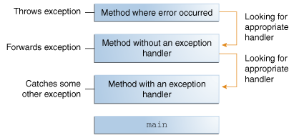
What is an Exception
An exception is an event, which occurs during the execution of a program, that disrupts the normal flow of the program's instructions.
When an error occurs within a method, the method creates an object and hands it off to the runtime system. The object, called an exception object, contains information about the error, including its type and the state of the program when the error occurred. Creating an exception object and handing it to the runtime system is called throwing an exception.
After a method throws an exception, the runtime system attempts to find something to handle it. The set of possible "somethings" to handle the exception is the ordered list of methods that had been called to get to the method where the error occurred. The list of methods is known as the call stack (see the next figure).

Slide 4
The try catch Block
try {
// Normal program flow
} catch (Exception e) { // Type of the exception
// Exception handling
} finally {
// Will be executed no mather if exception occured or not
}

Slide 5
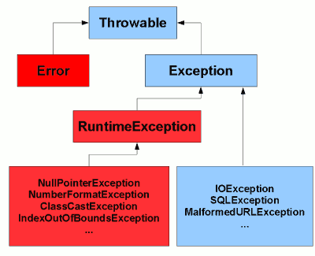
Checked vs Unchecked Exception
Checked Exception
The exception is checked by compiler. Java forces you to handle this exception.
ex: IOException, SqlException
Unchecked Exception
The exception is not checked by compiler
ex: RuntimeException, NullPointerException

Slide 6

Java 8 Features
Lambda Expression
Stream
Optional

Slide 7
Lambda Expression
To simplify anonymous class declaration. Lambda expression facilitates functional programming, and simplifies the development a lot.
new Kendaraan() {
public String maju () {
return "Kendaraan Maju";
}
}
() -> "Kendaraan Maju"

Slide 8
Stream
Stream represents a sequence of objects from a source, which supports aggregate operations.
Conveyor Belt | Raw material | Material selection | Material processing | Quality control | Packaging
Java Stream | Collections or Array | .filter() | .map() | .filter() | .collect()

Slide 9
Optional
Optional is a container object used to contain not-null objects. Optional object is used to represent null with absent value. This class has various utility methods to facilitate code to handle values as ‘available’ or ‘not available’ instead of checking null values.
String graphicCardMemory = null;
if(computer != null) {
if(computer.getGraphicCard() != null) {
graphicCardMemory = computer.getMemory();
}
}
if(graphicCardMemory == null)
graphicCardMemory = "None";
String graphicCardMemory = Optional.ofNullable(computer)
.map(Computer::getGraphicCard)
.map(GraphicCard::getMemory).orElse(“None”);
Computer
graphicCard
name
memory
processor
brand
coreNumber

